Slide 1
CISC 181 – 052L
March 16, 2021
UD

Slide 2

some quick things

Slide 3
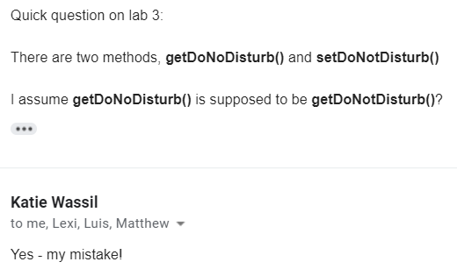

Grading
I only grade labs and lab attendance
[OTHER TA] handles the Zybooks homework
[OTHER TA’S EMAIL]
Wassil produces the labs
But if you see anything that’s weird or confusing, do not hesitate to email me.
Most problems I’ve relayed to Wassil

Slide 4
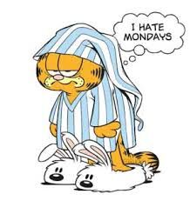
Labs Now Due on Mondays
That way we all have a fresh start on Tuesday Labs
Keeps the schedule in sync
Have the weekends to work on the labs
But please do try to do them earlier!
Poll: Would you like me to host an office hours on the weekend?
Or maybe later when the labs get more challenging?

Slide 5
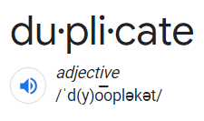
No Duplicate Behavior
No duplicate code, by that I mean no duplicate behavior
I said this last lab
milesPerGallon = 2;
milesPerGallon = 4;
distance = milesPerGallon * gasInTank;
We never want to have code that does the same thing twice
Don’t want to waste time
Which of these is duplicate behavior?
Is?
No, it is NOT a duplicate. Doesn’t appear anywhere
Is?
No, same reason^
Is?
No

Slide 6
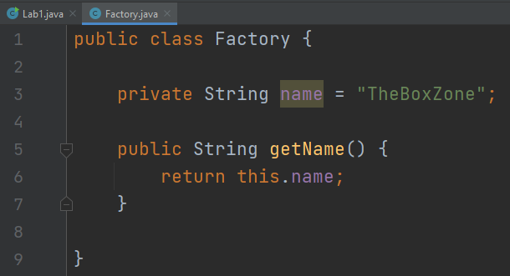
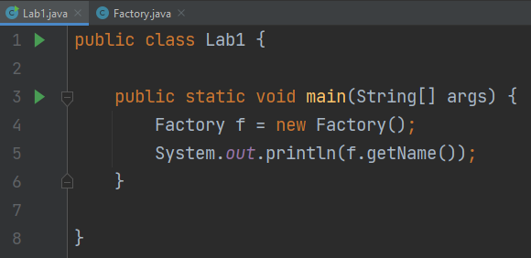
this & this()
Consider the two classes, Factory & Lab1

Slide 7
this & this()
Disclaimer: Address values are not accurate. They will differ based on Operating System (OS),
Java Virtual Machine (JVM), and other factors.
Memory/RAM
Address
Value
Factory Attribute | Data
this reference | 8 bytes
String name | 10 chars * 2 bytes/byte = 20 bytes
Factory.name | 3 instructions ≈ 3 bytes
0x00000
<Java Stuff>
First, we bring the Factory to life
Second, we then access the name var
…
…
0x0024F
Lab1.main code
…
…
0x0028B
Factory f reference
= 0x09AA2
0x09AA2
Factory instance
0x09AB0
String name reference
= 0x10BF3
0x09AC0
Factory.getName
code
Suppose we didn’t say this.name
How does Java know what name
variable are we referring to?
…
…
0x10BF3
String name value
= “TheBoxZone”

Slide 8
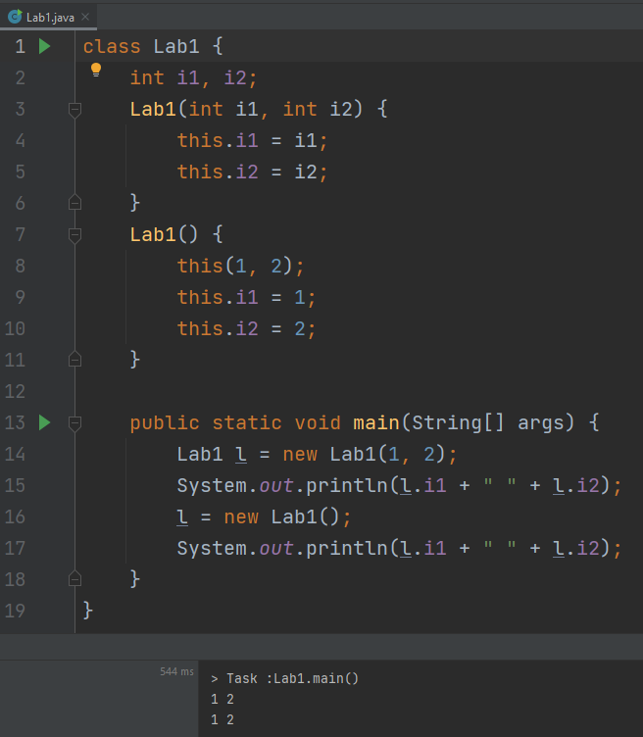
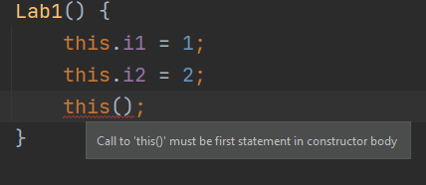
this & this()
Okay, now consider another example
Lines 9 and 10 are redundant
Also, we don’t need to call this() multiple times, you can only call it once
If you do call this(), it must be the first statement of your constructor

Slide 9
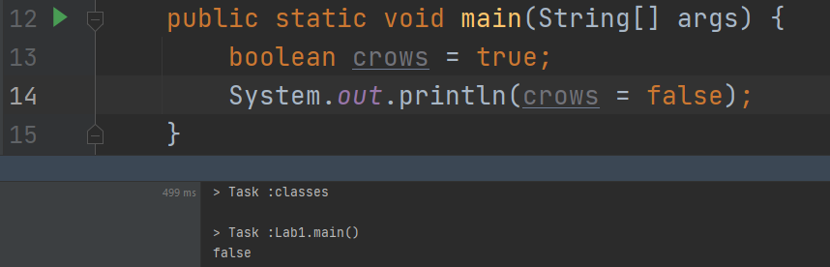
== & =
== means comparison. Does this equal something else
= means assignment. Setting a variable’s value
This will return what you assign
Hidden error

Slide 10
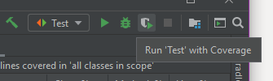
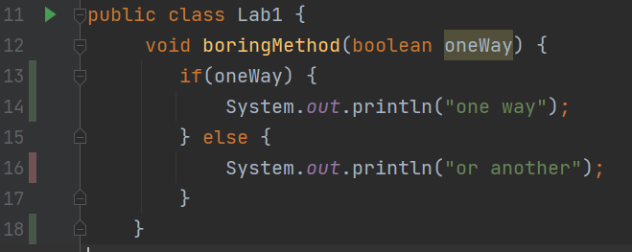
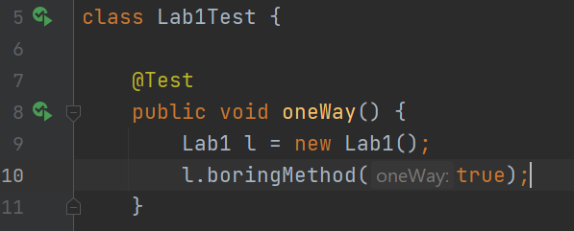
Unit Testing & Edge Cases
When we unit test, we want to have 100% code coverage
Test every branch
We need to make sure every “branch” of code is reached
Make sure you select “Run ‘App’ with Coverage” with your Test configuration!

Slide 11
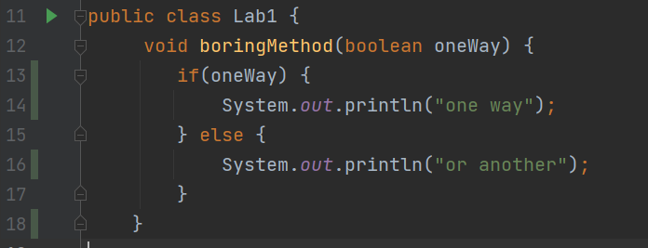
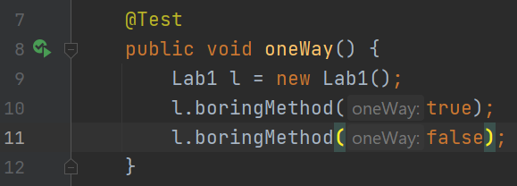
Unit Testing & Edge Cases
Keep adding tests until you hit every case
But also think about edge cases
<=, >=, <, >, == in conditionals
Edge cases can be more meta
Just to be aware of this

Slide 12
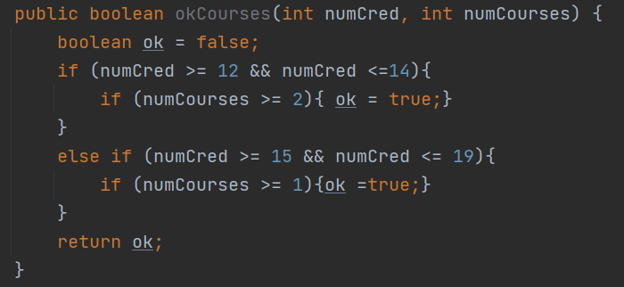
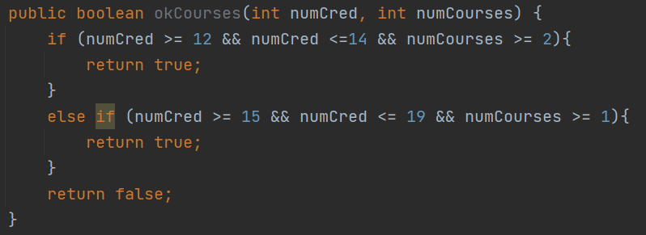
Boolean Logic
A complex topic (CISC 304), but a good one
We want to keep logic as simple as possible
For quite a few methods below, we want to assume that the answer is false until we can prove other wise.
Think a dead man’s switch

Slide 13

style

Slide 14
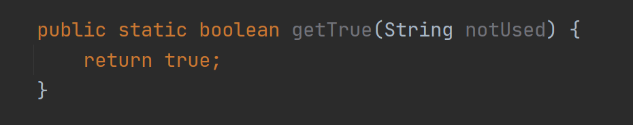
The Method Signature
Optional
Method Signature
How we uniquely
identify every method
Access Modifier
private, protected,
(default), and private
Static Declaration
Indicate if a method
is static or not
Return Type
void, primitives,
and Objects
Method Name
What name to
call the method
Parameters
What can be passed
to a method
Method Body
Everything in a method
that can be executed
Only one return type
In camelCase
In camelCase
In camelCase

Slide 15

What Access Modifier to Use
Getters/setters
AKA accessors/mutators
We almost always want them public
Otherwise, we generally use the most restrictive access modifier that we can reasonably use
Think of it like your house. Most people want it exclusively private within their family
Don’t make it public unless it needs to be
What is protected and (default) access modifiers?

Slide 16
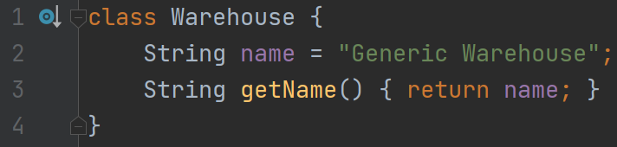
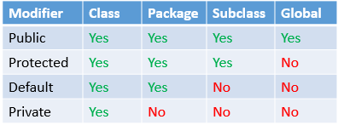
Access Modifiers: Protected & (default)
Protected and (default) are just other access modifiers
(default) means that no access modifier is listed
Okay, now, what the h*ck is a package?
(default)
(default)
(default)

Slide 17
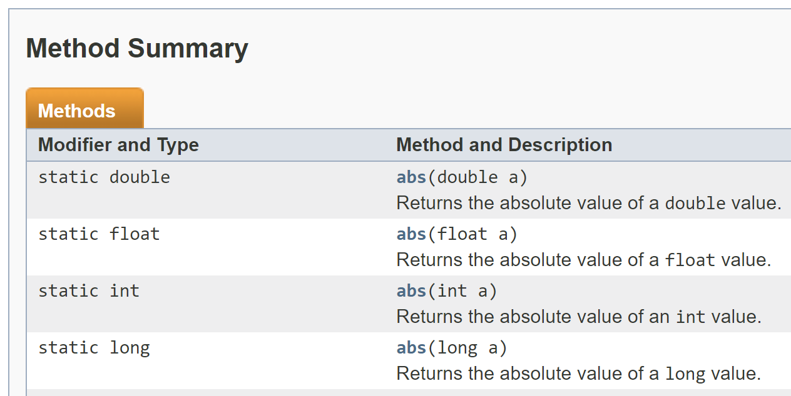
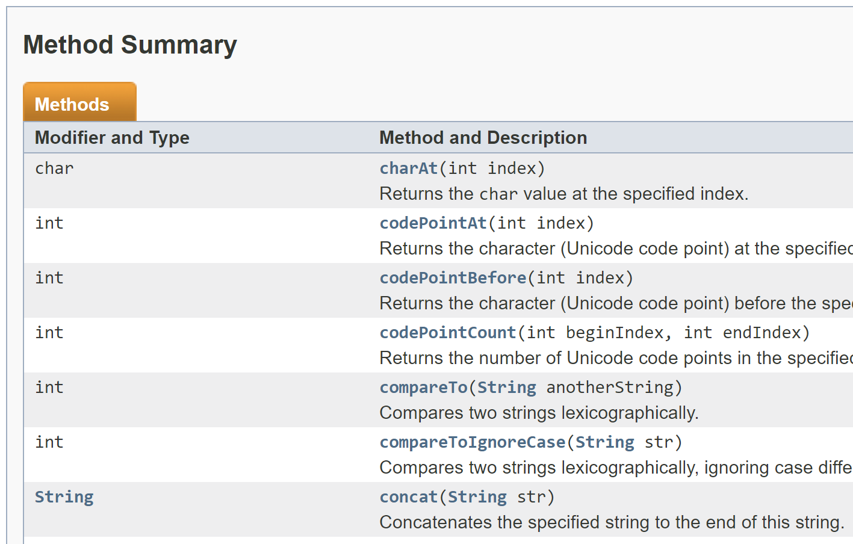
Static
https://docs.oracle.com/javase/7/docs/api/java/lang/Math.html
Math library
What is static?
One of the trickiest concepts for new students
Personally, it took me about a year and a half to understand it
Instance, instance, instance
https://docs.oracle.com/javase/7/docs/api/java/lang/String.html
String library

Slide 18
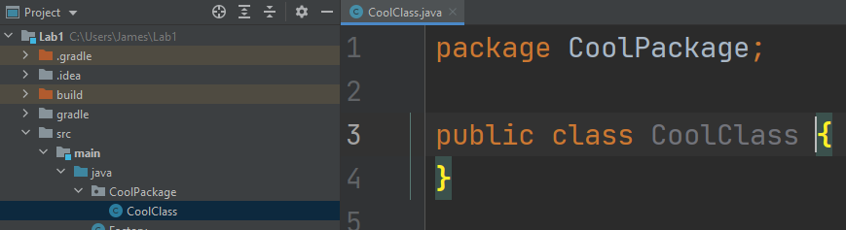
Packages
Packages are just folders (not even fancy, really)
They’re used to organize classes that are similar
Same naming scheme (FirstLetterCapitalized)
Package declaration must be in all classes in that package

Slide 19

Looking ahead to lab 3

Slide 20
the new stuff for Lab 3 (overview)
Objects, Classes
Encapsulation
Inheritance
Arrays with Primitive Types

Slide 21
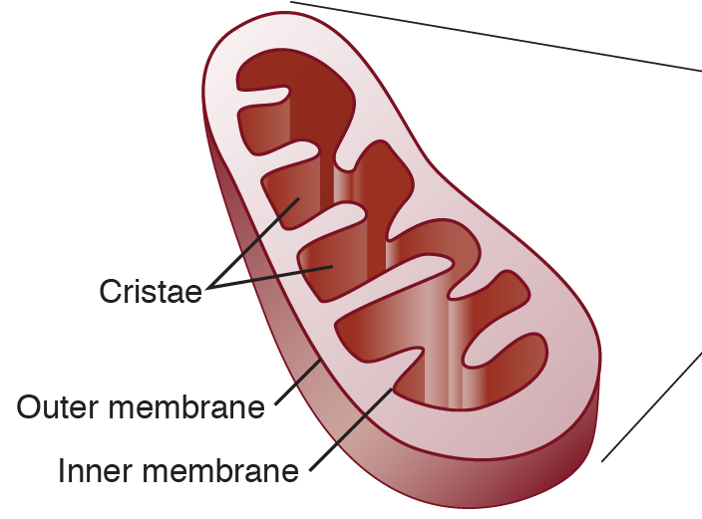
Encapsulation
The powerhouse of the cell
variables
Is just literally what it sounds like
Class
Attributes (class variables)
Methods (that do a certain behavior)
Used to protect the delicate attributes
Imagine a Java class called Bank
We don’t just want anyone to withdraw from the bank
We need to keep a ledger to keep track of who has what
Overdraft protection
class
methods

Slide 22
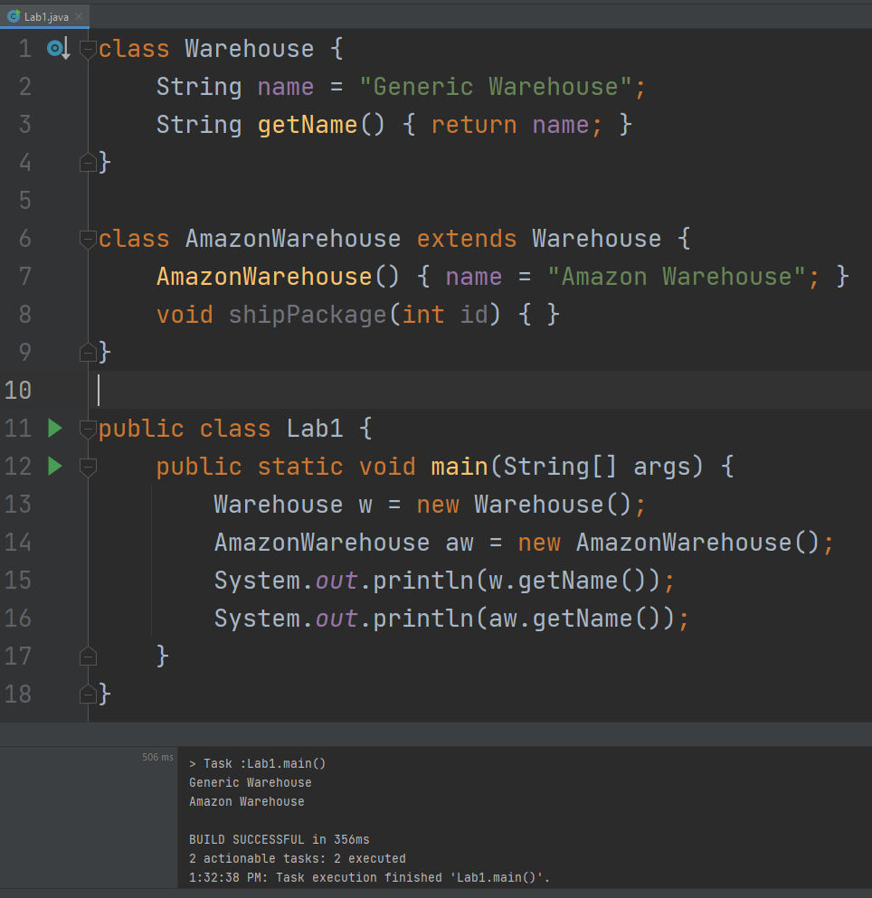
Inheritance
Classes can extend other classes to inherit all the attributes what the super class has
We can access everything that is in a super class

Slide 23
Inheritance
1st Generation
Super class
Classes can extend another class to inherit what the super class has.
A class can only extend one class in Java
PHP and Python allow you to extend multiple classes
A class can be extended multiple times
Why would we want to do this?
sibling
class
2nd Generation
class
3rd Generation
subclass
subclass

Slide 24
Java Types
But I can re-assign strings! Yes, you can, but it’s just pointing to a new String in the Java String Heap
Data Types
Immutable: Never changes
String
Literals: Does NOT need
the new keyword.
Primitive
Non-primitive
boolean (1 bit)
Int
byte (1 byte)
Non-literals:
Does need the
new keyword
Objects
…
Whole numbers
short (2 bytes)
int (4 bytes)
Factory
long (8 bytes)
Lab1
float (4 bytes)
Fractional Numbers
There are many diagrams about this online, but most are misleading or wrong.
8 bits to a byte.
Generally, in programming, we want to use the least number of bits to store anything.
If you write a class that does not extend anything, it implicitly extends Object
double (8 bytes)
char (2 bytes)

Slide 25
Arrays with Primitive Types
Python has lists, which store references in sequential order
[0] -> [1] -> [2] -> [3] -> …
Every element in the list is “linked” to the next
Java has arrays, which stores references in sequential order
{0, 1, 2, 3, …}
Every element is stored next to each other in memory, and simple pointer arithmetic can be used to find any element
Java
Python
Address | 0x01 | 0x02 | 0x03 | 0x04 | 0x05
Value | 0 | 1 | 2 | 3 | …
Address | 0x00 | 0x12 | 0xC4 | 0xD2 | 0xF1
->Value | 0 | 1 | 2 | 3 | 4
->Next | 0x12 | 0xC4 | 0xD2 | 0xF1 | null
Size of data type: 1 byte

Slide 26
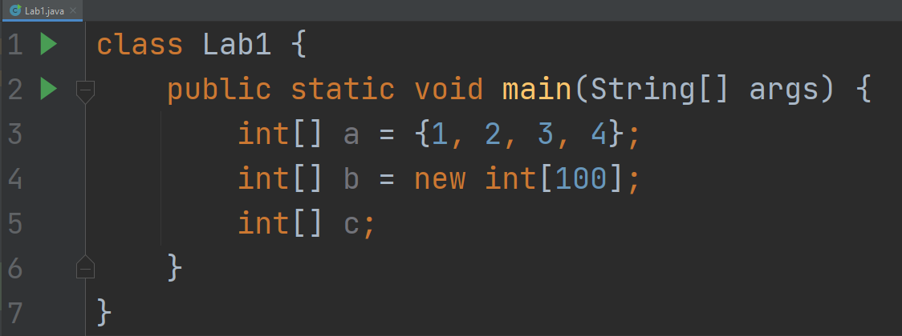
Arrays with Primitive Types
You can have an array of anything
Comes in three flavors
array initializer
array allocation
array variable

Slide 27
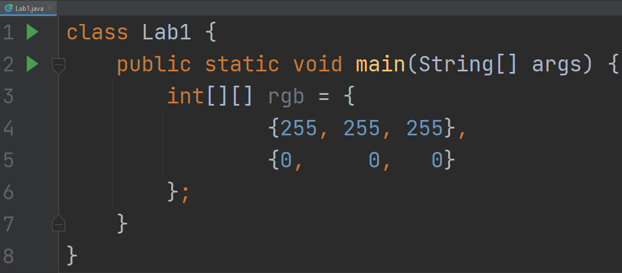
Arrays with Primitive Types
A single dimension of an array is indicated by []
For every [], we say something is “array of”
So, the below would be “array of array of ints”

Slide 28
Arrays with Primitive Types (Practice)
int[] ai; // array of int
short[][] as; // array of array of short
int s; // integer s
short aas[][]; // array of array of short
Object[] ao, // array of Object
otherAo; // array of Object

Slide 29
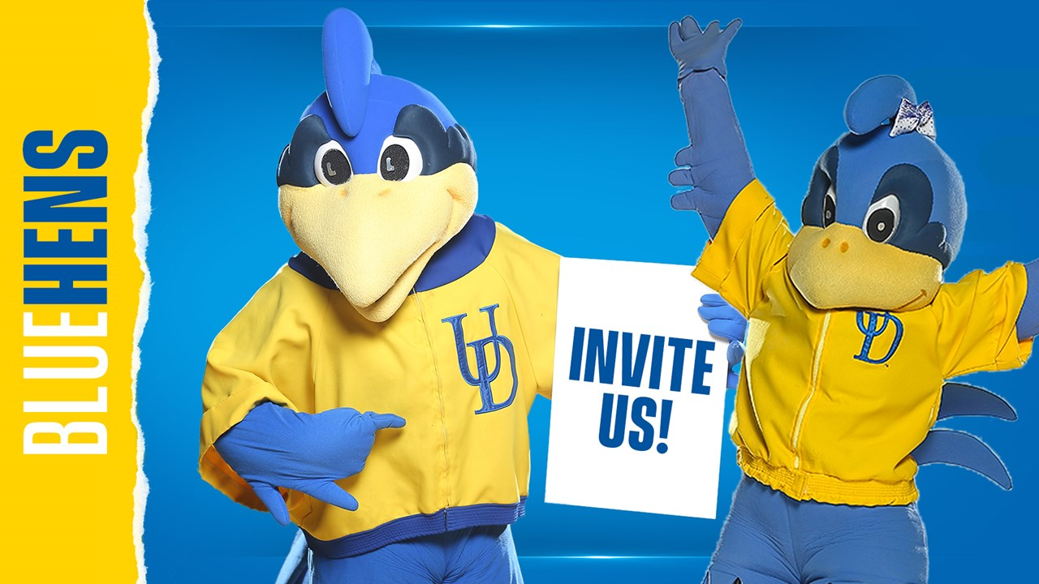
that’s all :)

